Slide 1

Computer Memory
Presented By:
Elizer Ponio Jr.

Slide 2
Computer Memory
What is Computer Memory?
Volatile and Non-volatile memory
Primary and Secondary memory
RAM Specifications
Memory Bandwidth
Memory Channels
Storage Devices

Slide 3
Memory makes us who we are

Slide 4
Memory
Enables us to remember the past.
Learn and retain skills.
Plan for the future.

Slide 5
What is Computer Memory?
Computer memory is any physical device capable of storing information temporarily or permanently.
Everything in a computer memory takes the form of basic units called binary digits.
Each binary digits are stored in a memory cell that can switch between two states for two possible values, 0 and 1.

Slide 6

What is Computer Memory?
Files and programs consists of millions of bits all processed by the CPU.

Slide 7
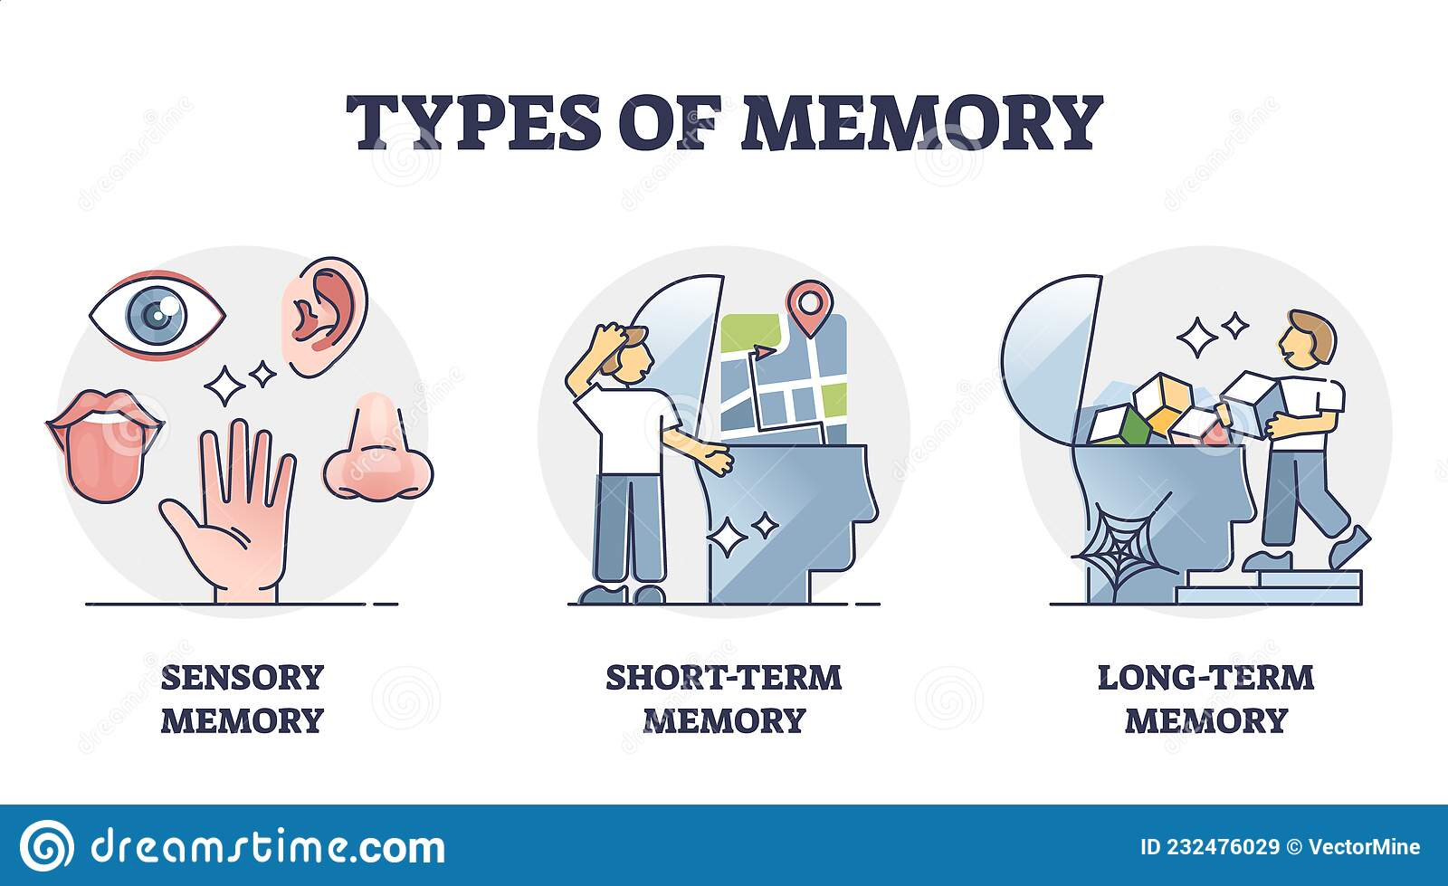

Slide 8
Volatile and Non-volatile Memory
Volatile memory is a type of memory whose contents are erased when the computer’s power is turned off or interrupted.
Non-volatile memory is a type of memory whose contents are saved regardless if the computer has power. Data stored on non-volatile memory remains permanent regardless if it has power, making it the best place to store your files such as pictures or videos.

Slide 9
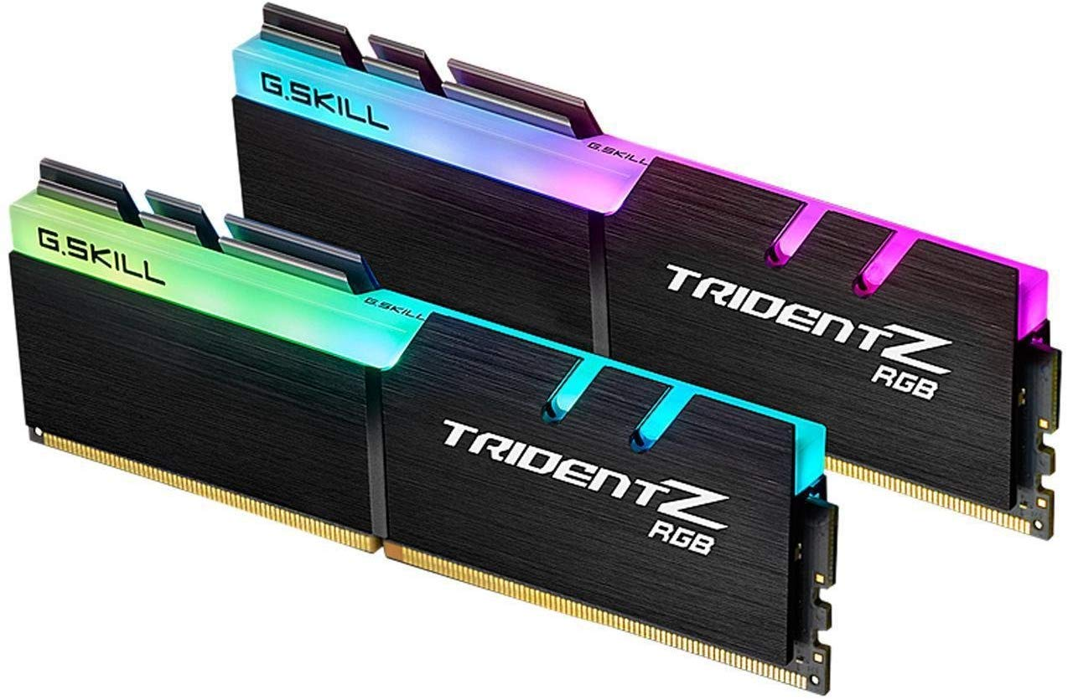
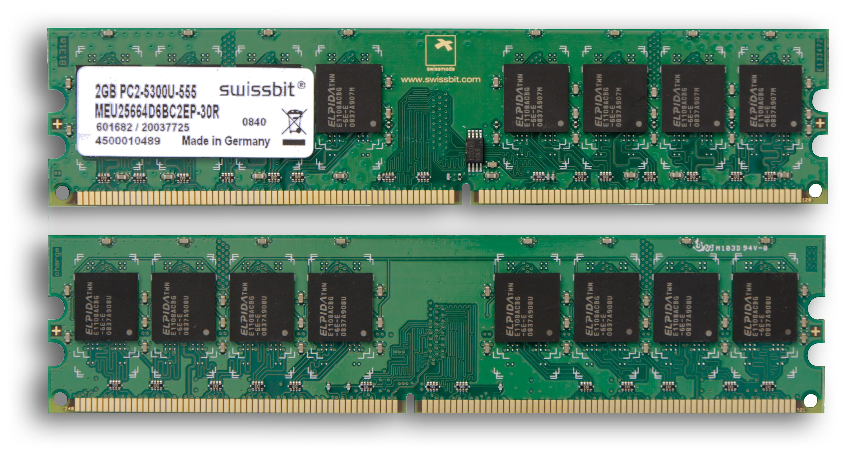
Volatile Memory
Standard RAM
RAM with aluminum heat spreader and decorative RGB lighting

Slide 10
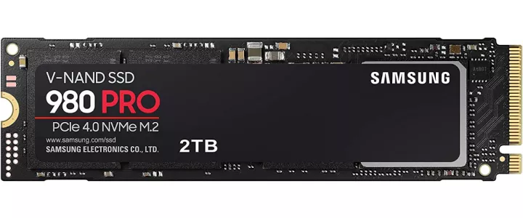
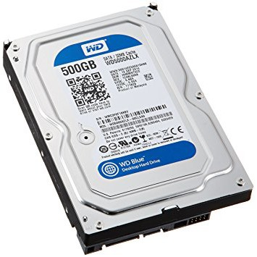
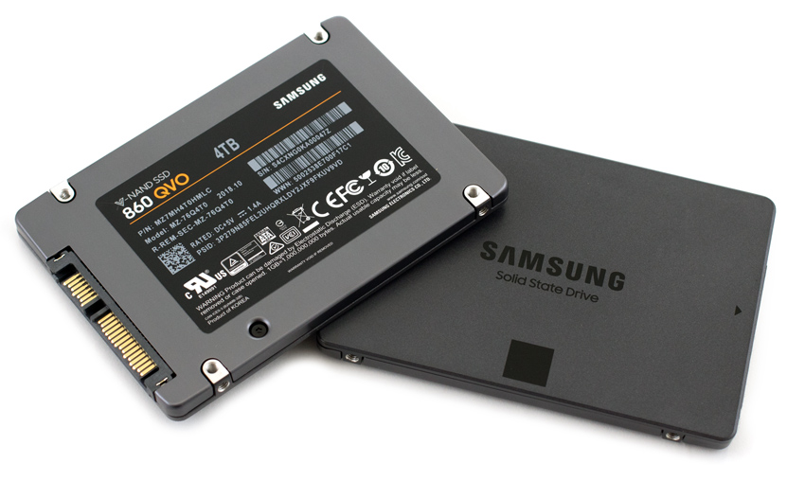
Non-volatile Memory
M.2 SSD
SATA SSD
Hard Disk Drive

Slide 11
Primary and Secondary Memory
Primary memory
“Short term memory” for immediate tasks such as opening a web browser, word processor.
DRAM and SRAM(CPU Cache).
Secondary memory
“Long term memory” for permanent storage.
Hard Disk Drives (HDD), Solid State Drives (SSD), Optical Disks (CD-ROM), USB Flash Drives.

Slide 12
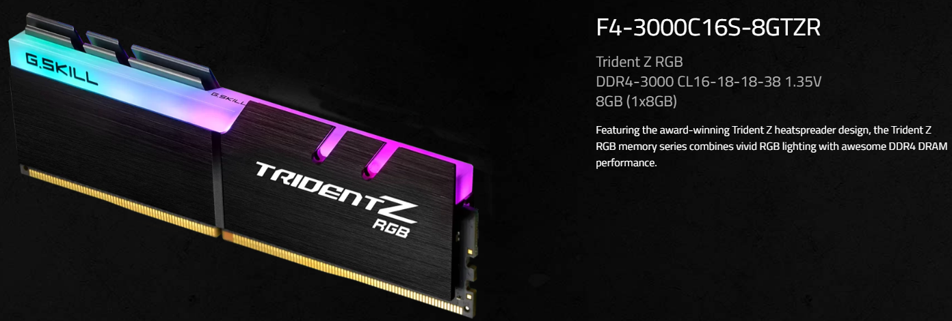
RAM Specifications
Model Name: Trident Z RGB Memory Type: DDR4 Frequency: 3000 Latency/Timing: CL16-18-18-38 Voltage: 1.35V Capacity: 8GB (1x8GB)

Slide 13
Double Data Rate (DDR)
DDR transfers data to the processor on both the rising and falling edges of the clock signal.
Trident Z RGB DDR4-3000 CL16-18-18-38 1.35V

Slide 14
Double Data Rate (DDR)
 | Single Data Rate (SDR) | DDR | DDR2 | DDR3 | DDR4 | DDR5
Year | 1988 | 2000 | 2003 | 2007 | 2014 | 2021
Prefetch | 1 – Bit | 2 – Bit | 4 – Bit | 8 – Bit | Bit per Bank | 16 - Bit
Data Rate (MT/S) | 100 – 166 | 266-400 | 533-800 | 1066-1600 | 2133-5100 | 3200-6400
Transfer Rate (GB/s) | 0.8 – 1.3 | 2.1 – 3.2 | 4.2 – 6.4 | 8.5 – 14.9 | 17 – 25.6 | 38.4 – 51.2
Voltage (V) | 3.3 | 2.5 – 2.6 | 1.8 | 1.35 – 1.5 | 1.2 | 1.1

Slide 15
RAM Frequency
The amount of data the RAM can send and receive each second.
Measured in megahertz (MHz).
One Hertz (Hz) is a single clock cycle per second.
One megahertz (MHz) is equal to one million hertz (Hz).

Slide 16
RAM Frequency
Trident Z RGB DDR4-3000 CL16-18-18-38 1.35V

Slide 17

Latency Explained
Latency can be defined as the gap in time between some kind of input/request and the response/output of a certain system.

Slide 18



Latency Explained
How are you?
I am fine

Slide 19
RAM Latency/Timings
In terms of RAM, latency is defined as the time or delay between initiating a request to retrieve data that is in memory and the response or retrieval of data from memory.
Latency is a fundamental measure of the speed of memory.
The less the latency, the faster the reading operation.

Slide 20
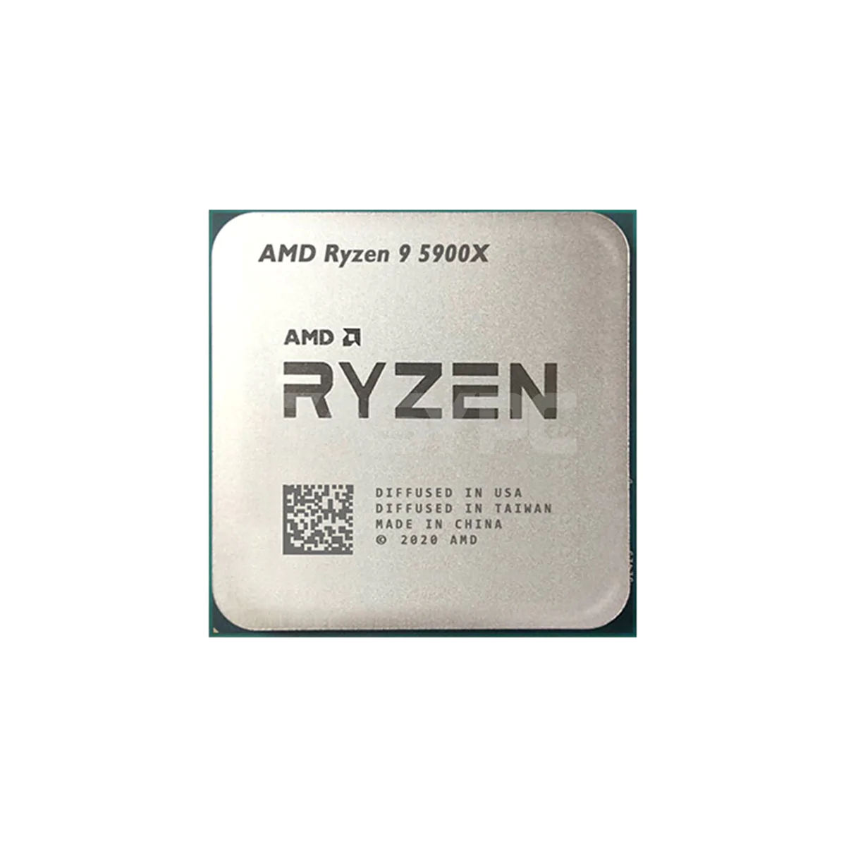
RAM Latency/Timings
Request
Response

Slide 21
RAM Latency/Timings
Trident Z RGB DDR4-3000 CL16-18-18-38 1.35V

Slide 22
CAS Latency
16-18-18-38
Column Access Strobe (CAS)
The time it takes for the RAM module to start responding to a request for data.
Measured in clock cycles.

Slide 23
True Latency
True Latency = (CAS Latency / RAM Speed) X 2000

Slide 24
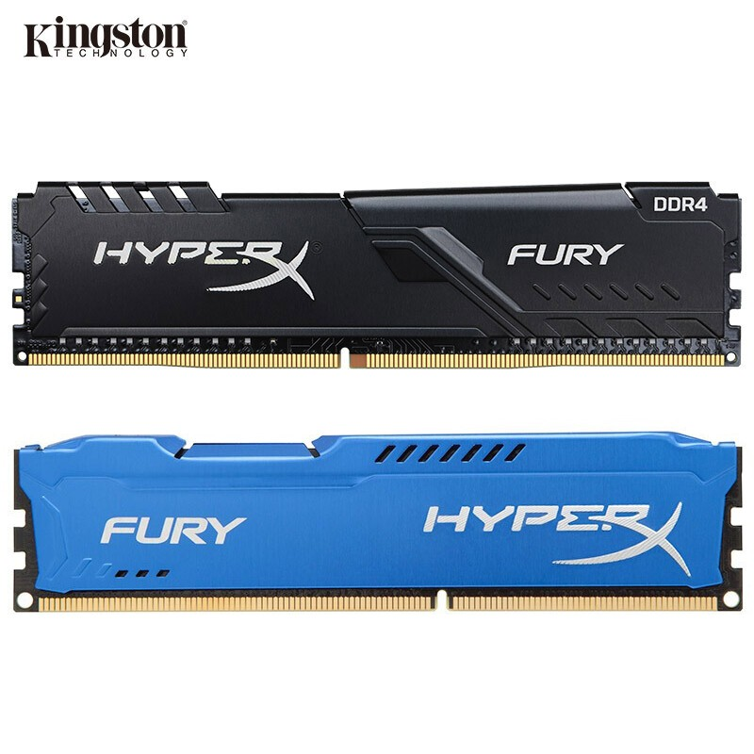
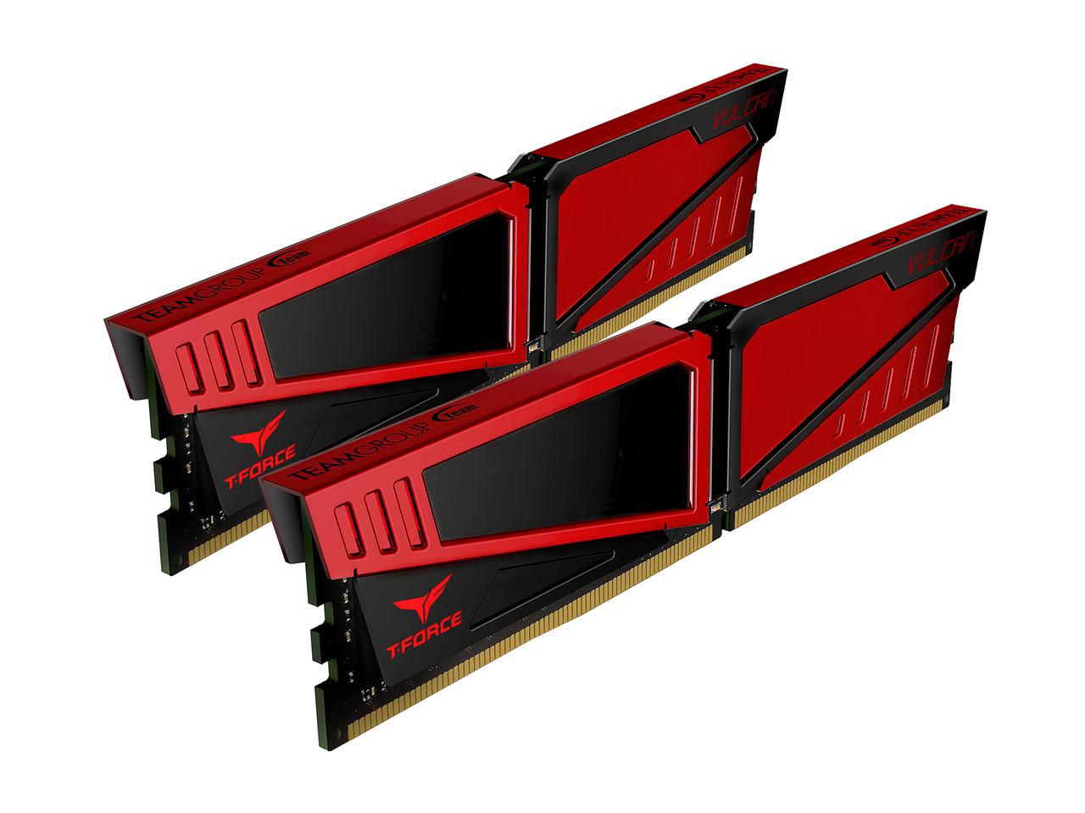
True Latency
DDR4 -1866
CAS Latency: 13
True Latency = 13.93 nanoseconds
DDR4-2400
CAS Latency: 13
True Latency = 14.17 nanoseconds

Slide 25
RAM Latency/Timings
16-18-18-38
Row address to column address delay (TRCD)
Latency between row and column access
Row pre-charge time (TRP)
Latency when opening a new row.
Row active time (TRAS)
- Minimum number of clock cycles a row must stay open to ensure that data is read or written properly.

Slide 26
Memory Bandwidth
In terms of memory, bandwidth is the max volume of data that RAM can transfer to the CPU and that the CPU can transfer back to RAM.
Measured in megabytes per second (MB/s) or gigabytes per second(GB/s)

Slide 27

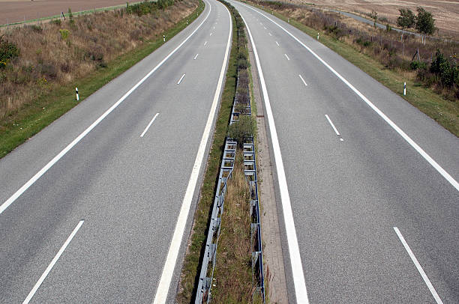
Memory Bandwidth
Two lane highway
Four lane highway

Slide 28
Memory Channels
RAM can come in single, dual and quad channel kits.
Dual channel memory will double the memory bandwidth
Quad channel memory will quadruple the memory bandwidth.

Slide 29
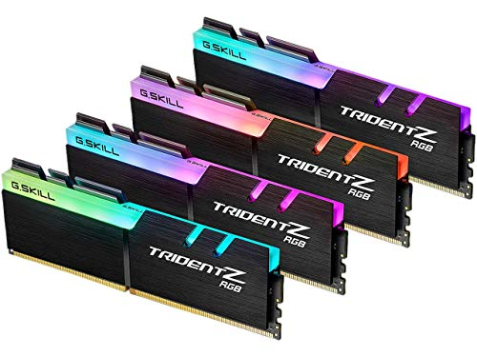
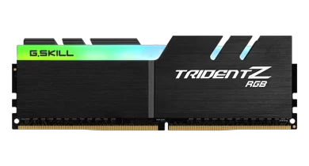
Memory Channels
Single Channel
Dual Channel
Quad Channel

Slide 30
Storage Devices
Hard Disk Drive (HDD)
A kind of non-volatile memory that use spinning disks to magnetically store information.
Data is stored as a magnetic pattern on a spinning disk.
Solid State Drive (SSD)
A kind of non-volatile memory that store data by trapping or removing an electrical charge.
SSDs are much faster than HDDs as there are no moving parts, and therefore no time to move the read/write arm around.

Slide 31
HDD vs SSD
 | Cost | Speed | Durability | Highest Capacity | Energy Efficiency
HDD | Cheaper | Slower | Less durable | 10TB | Uses more energy
SSD | More expensive | Faster | More durable | 4TB | Uses less energy

Slide 32
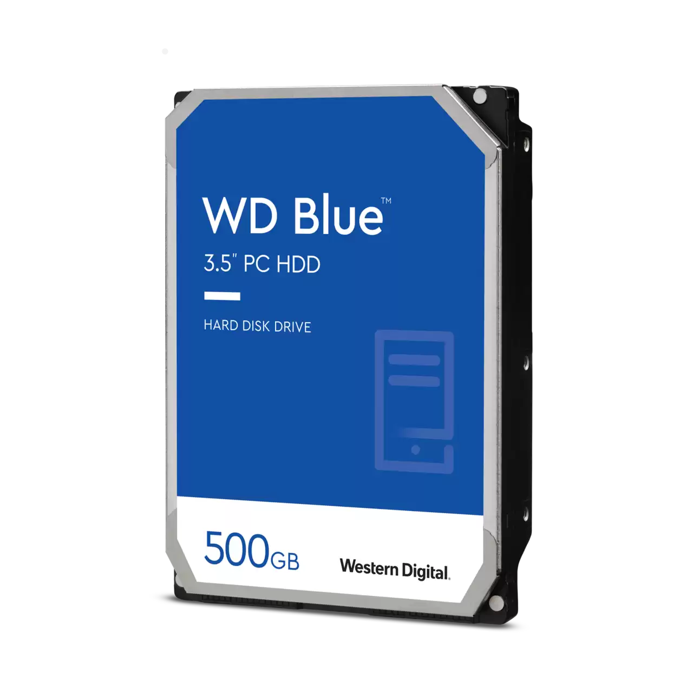
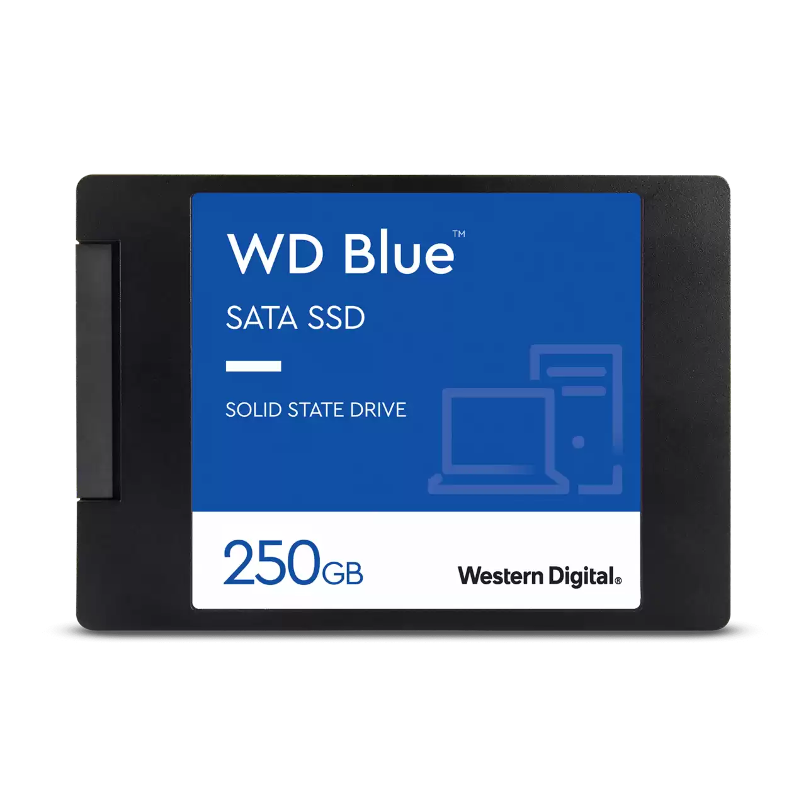
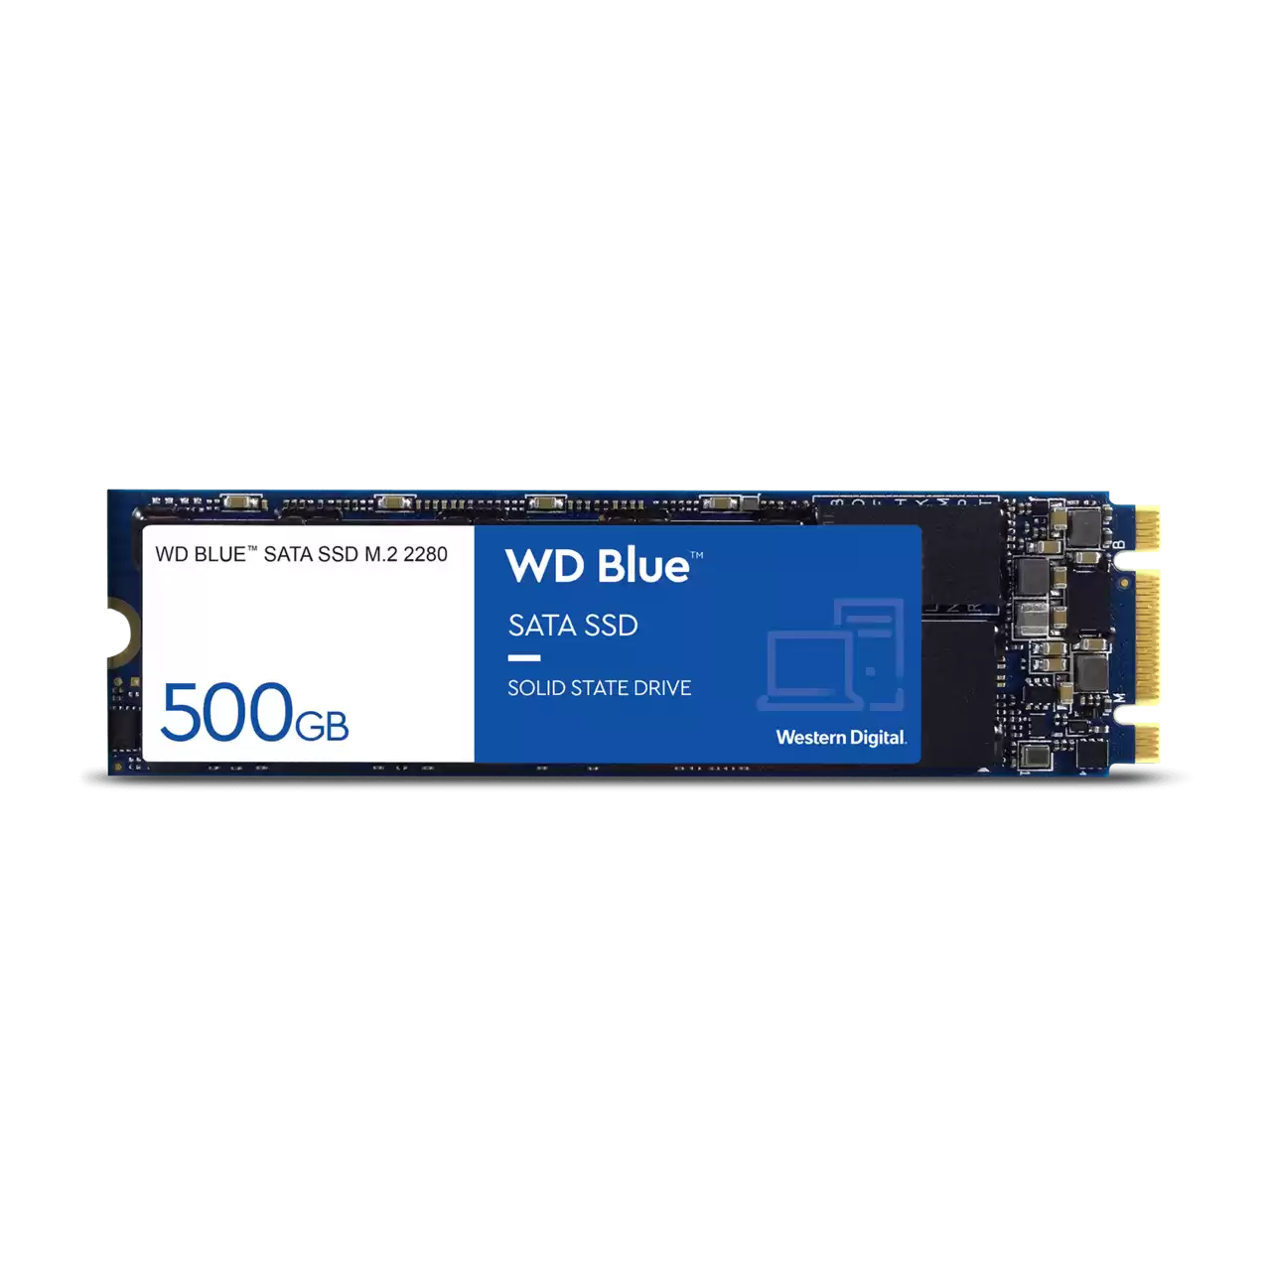
Forms of Storage Devices
Hard Disk Drive
SATA Solid State Drive (SSD)
SATA Solid State Drive SSD M.2

